Slide 1
Workforce Housing
Notes:
Created using iThoughts

Slide 2
Community Support

Slide 3
Available Land

Slide 4
Zoning Limitations

Slide 5
New Construction Methods

Slide 6
New Construction Methods

Slide 7
New Construction Methods

Slide 8
New Construction Methods

Slide 9
New Construction Methods

Slide 10
New Unit Form

Slide 11
New Unit Form

Slide 12
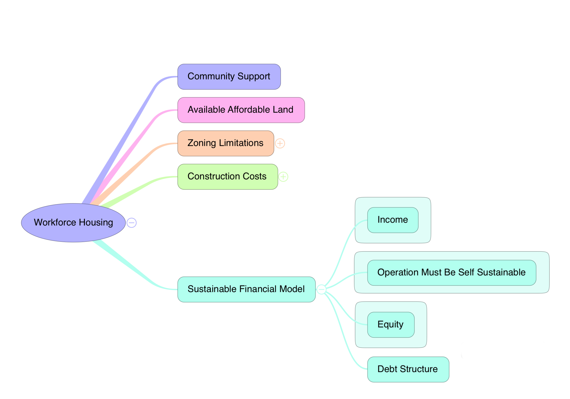
Sustainable Financial Model

