Slide 2
Agenda
Welcome/Context for Panel Discussion
Affordable Housing Challenges and Solutions – Kevin Griffith
Effective Affordable Housing Strategies– Kate Hartley
Overview of Good Design Principles – David Baker
New Model for Workforce Housing – Alan Talansky
Moderated Panel/Participant Discussion – Amit Price Patel
Concluding Remarks

Slide 3
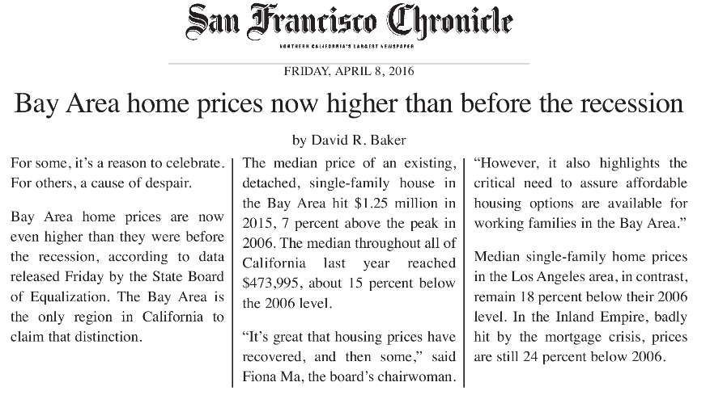
Bay Area’s Housing & Transportation Crisis
Since 2010: 500,000 new jobs/ 50,000 new housing units
2015 freeway congestion report worst on-record
Notes:
Long commutes
Crowding
Displacement pressure
Illegal units
Living in cars and RVs
Homelessness

Slide 4
New housing has met needs of high, but not low-and moderate-income, households.
Source: Association of Bay Area Governments (2016)

Slide 5
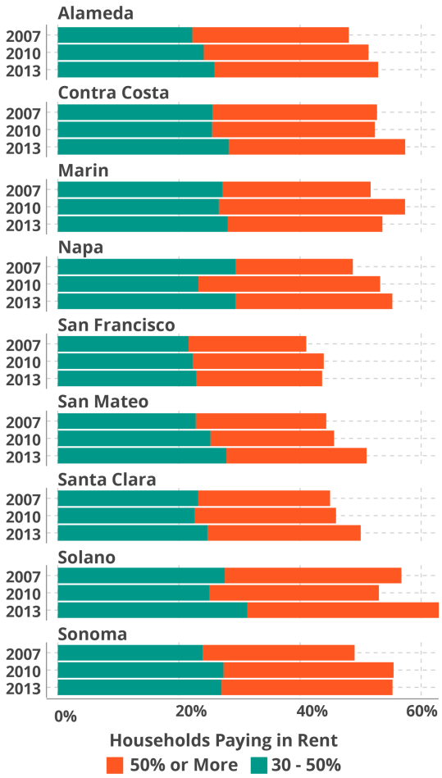
Housing Cost Burden is a Regional Issue
Rent as share of HH income
Source: ACS, ABAG

Slide 6
Housing Cost Burden is a Regional Issue

Slide 7
Annual Housing Funding Shortfall
(MTC & ABAG estimates)
County Housing Bonds – 7%
Funding Gap Estimate - 67%
Rents, Impact & Inclusionary Fees – 6 %
Notes:
The housing shortfall is comparable to the Plan Bay Area transit and roads shortfall, but lacks a strategy to be funded

Slide 8
Introductions

Slide 9
Questions for the panel?

Slide 10
Concluding Remarks
Ongoing regional efforts - PDA Planning
New efforts - Committee for Affordable and Sustainable Accommodations (CASA)
Multi-sector committee to identify game-changing solutions
Build regional consensus on legislative, regulative, financial and market-related measures
Identify near- and medium-term actions
Launch in early 2017

